Slide 1

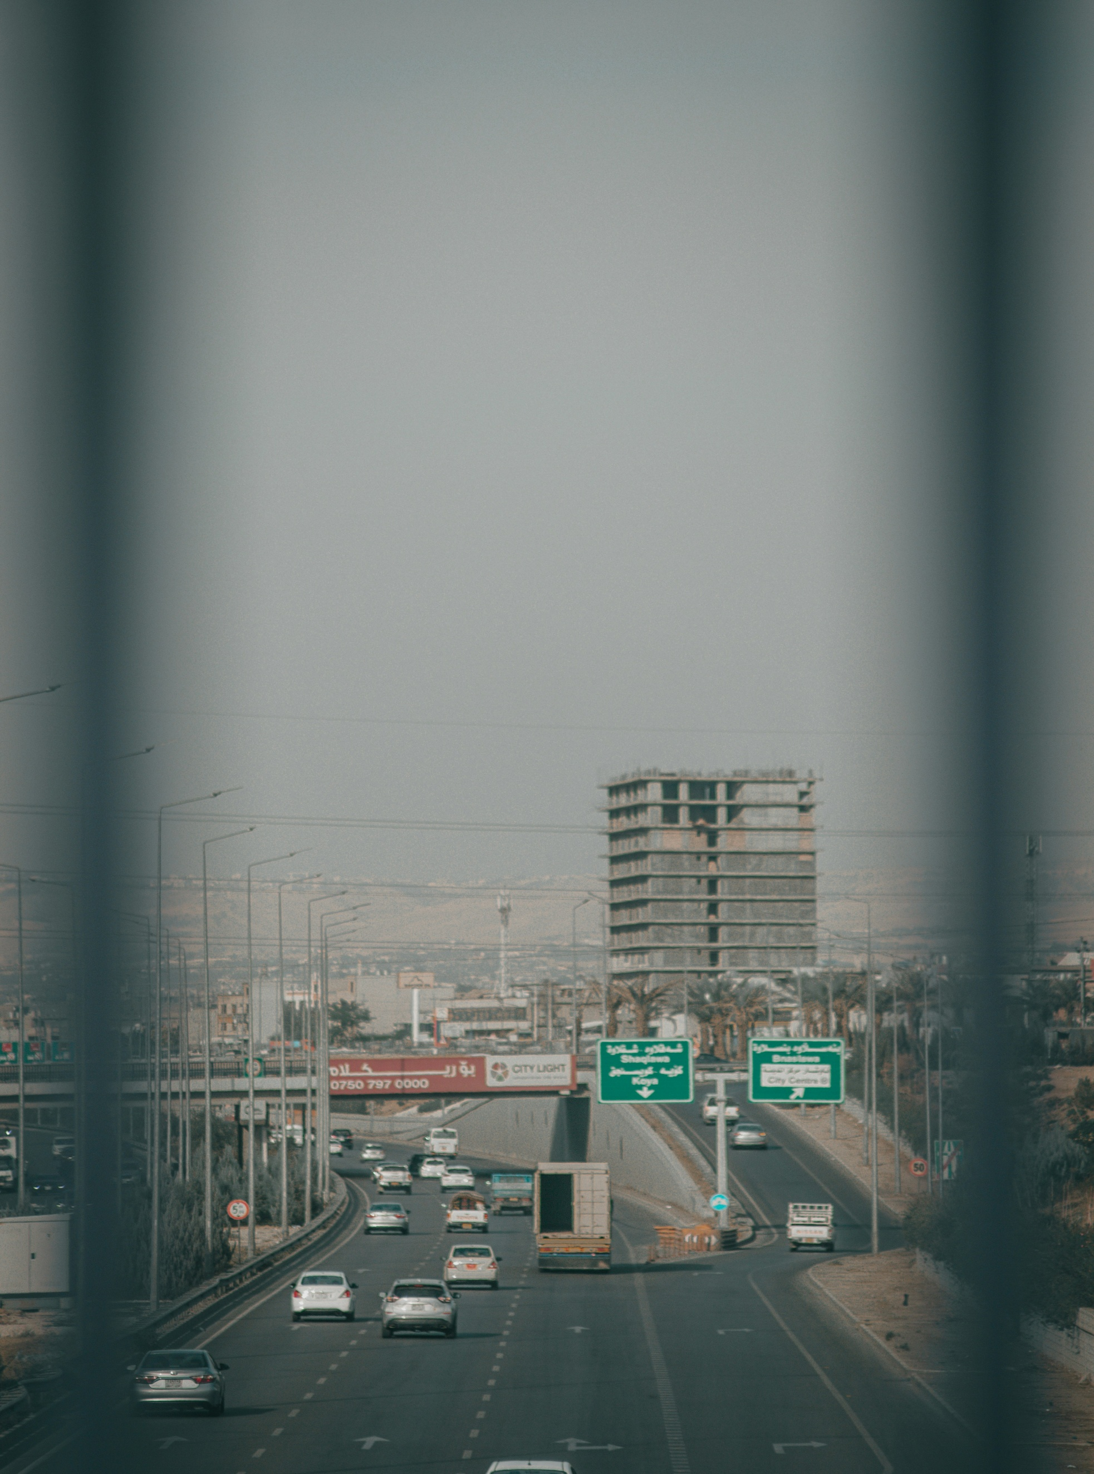
Autonomous Driving in Smart Cities:
Deep Learning for Traffic Optimization
Presented by
Moye Nyuysoni Glein Perry

Slide 2
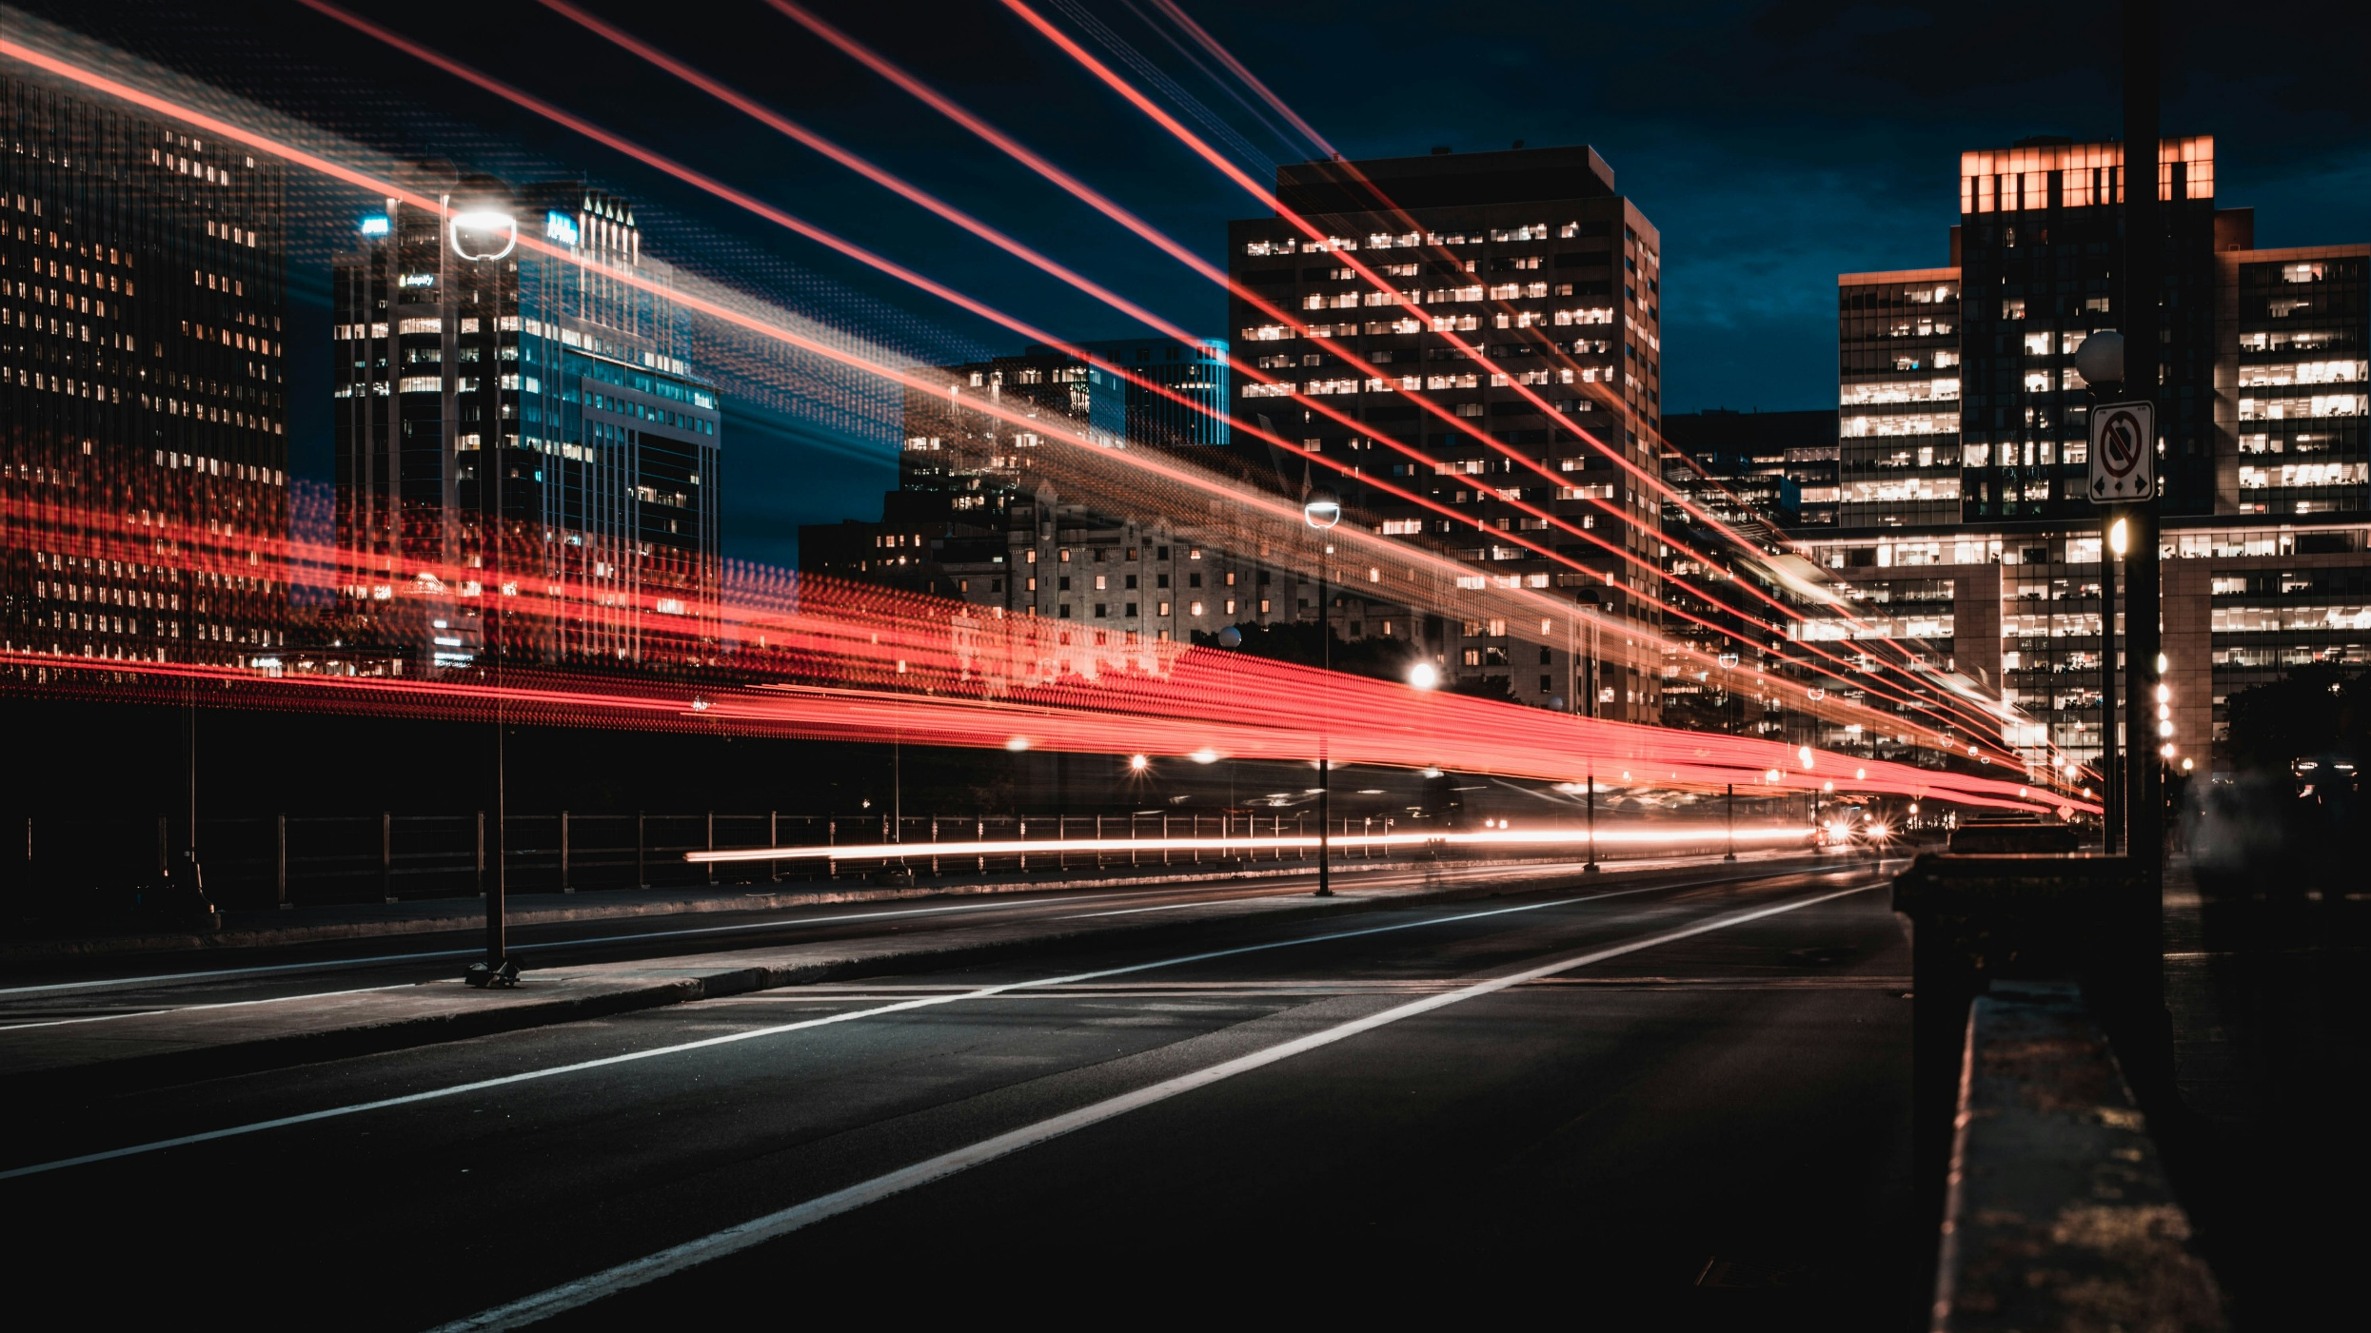
AGENDA
01
Introduction & Motivation
02
Deep Learning
03
Traffic Optimization

Slide 3
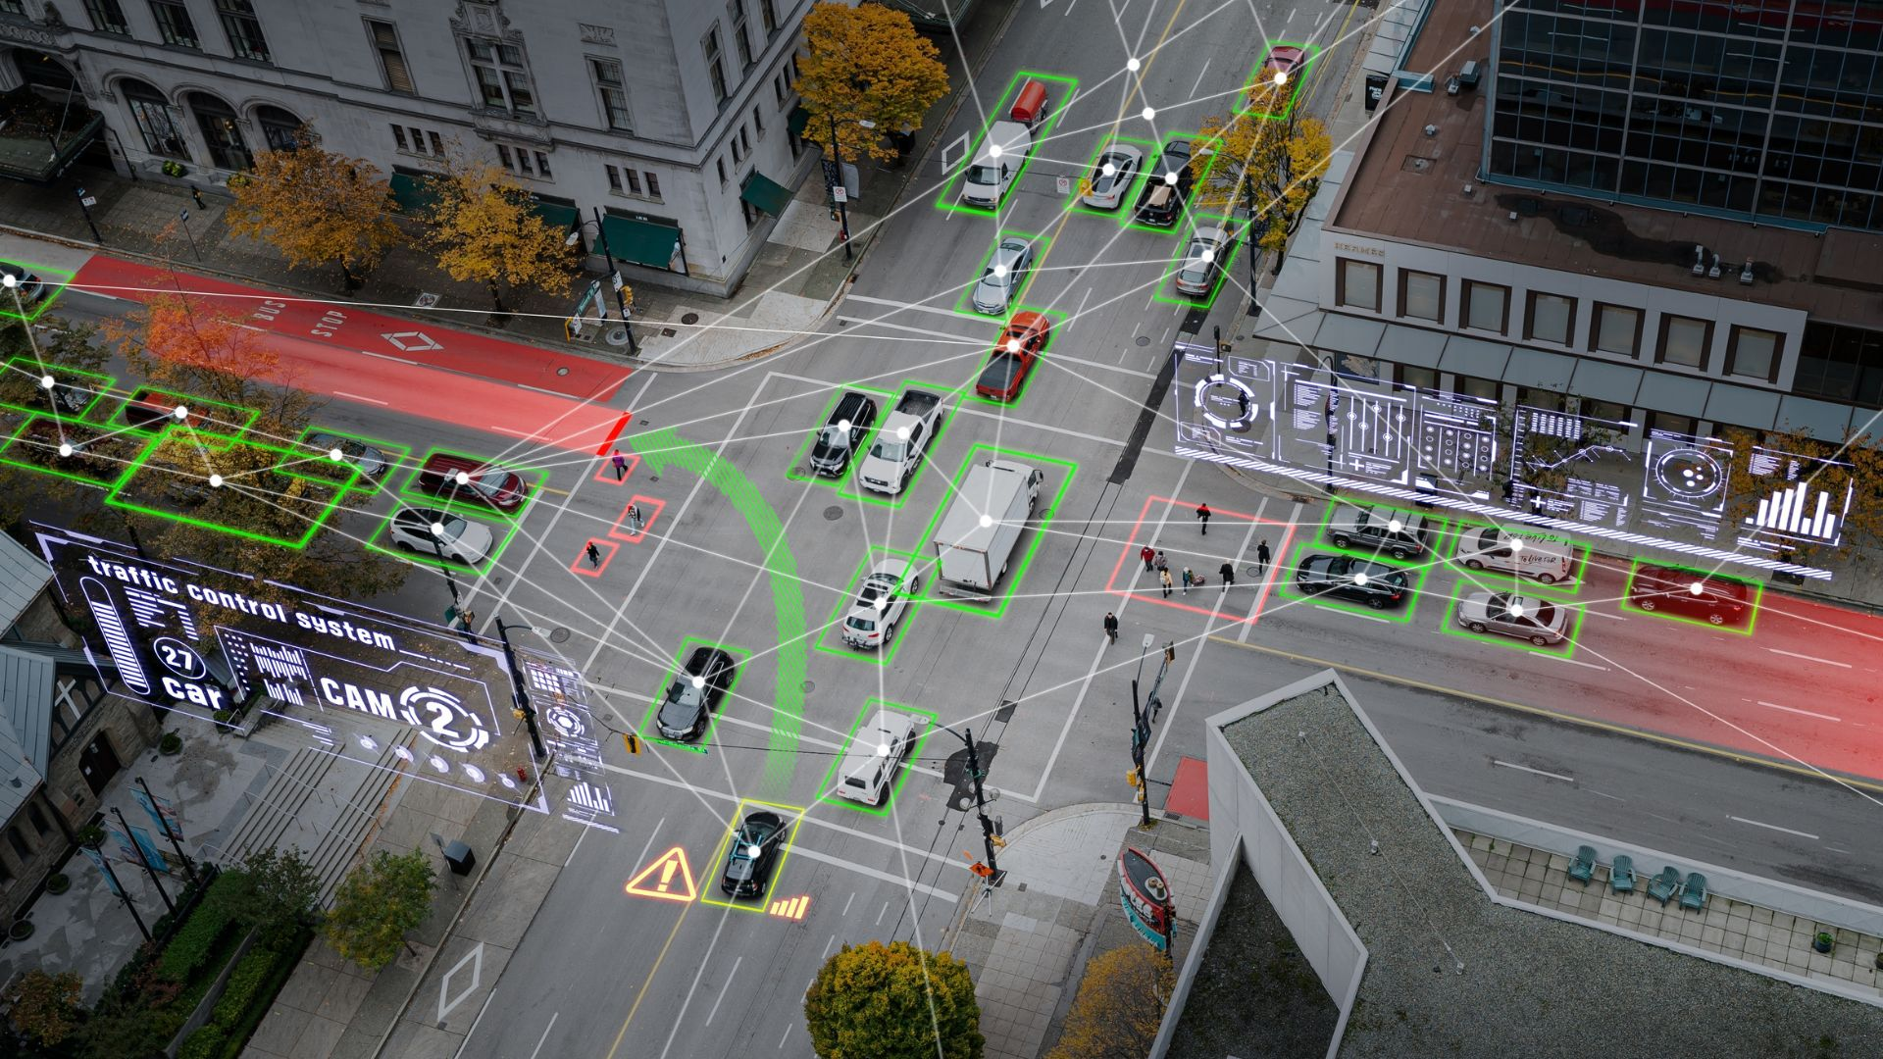
Camera-Based Vehicle Detection for Smart Traffic Optimization
Figure 1: Smart City
Vision-Based Traffic Sensing
Traffic Density Estimation
Adaptive Signal Control

Slide 4
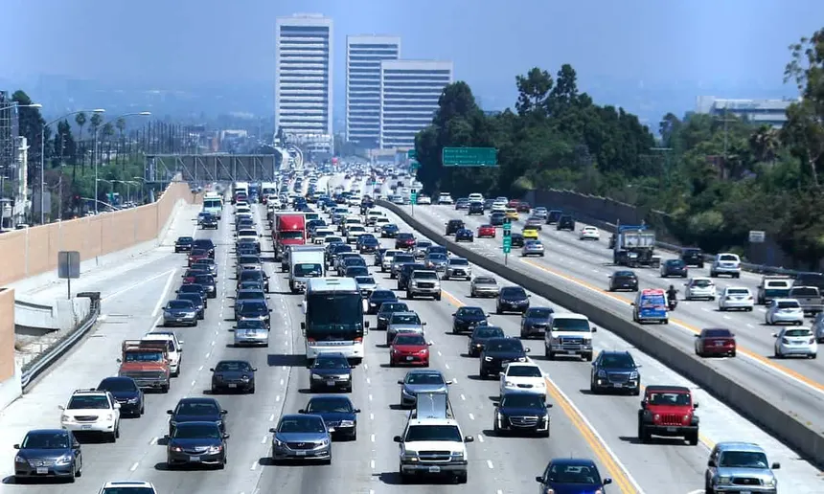
Motivation
Traffic congestion causes delays and unsafe driving
Harsh braking is a symptom of traffic instability
Smart cities require predictive, not reactive, traffic control
Deep Learning enables learning traffic dynamics from data
Figure 2: Highway

Slide 5
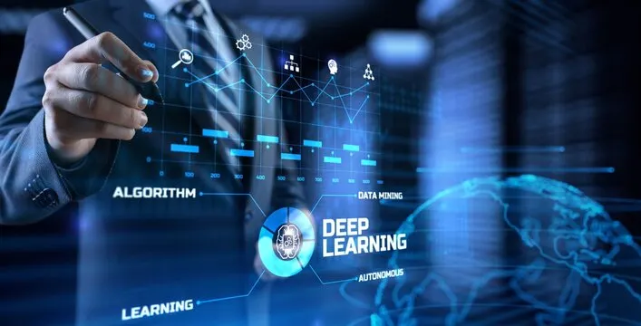
WHAT IS DEEP LEARNING?
Subfield of machine learning
Uses multi-layer neural networks
Learns complex, non-linear patterns
Particularly effective for time-series data
Figure 3: Deep learning

Slide 6
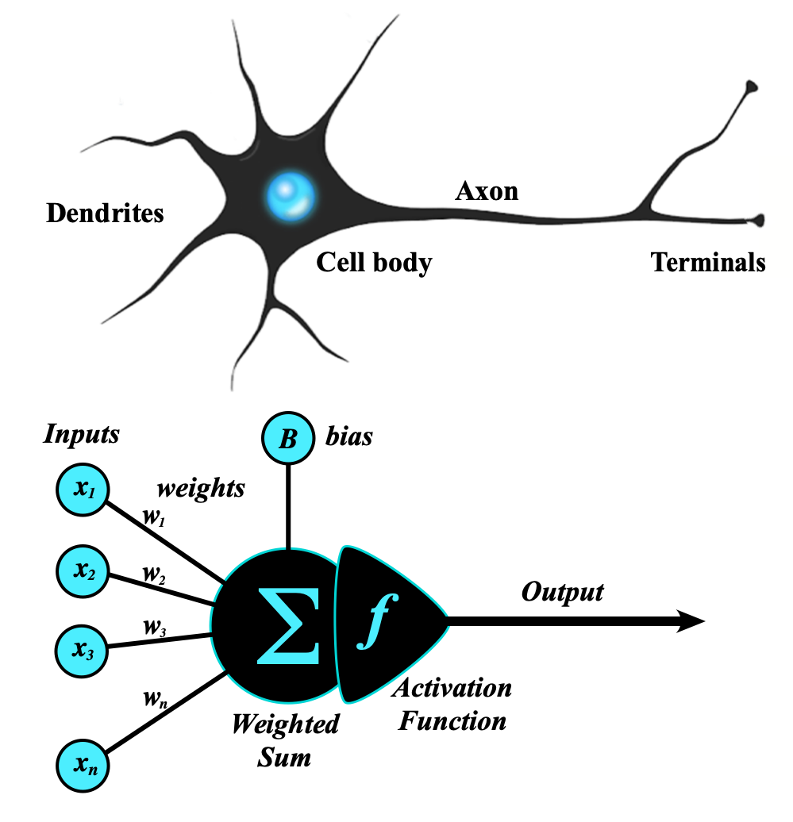
NEURAL NETWORK BASICS
Figure 4: Neural Network
Inputs → Hidden layers → Outputs
Weights and biases
Learning via backpropagation

Slide 7
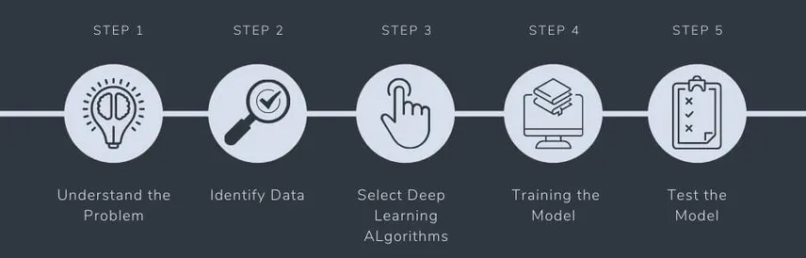
LEARNING PROCESS
Forward pass → prediction
Compute loss
Backpropagation
Update weights using optimizer
Repeat until convergence
Figure 5: steps to solving a Problem with deep learning

Slide 8
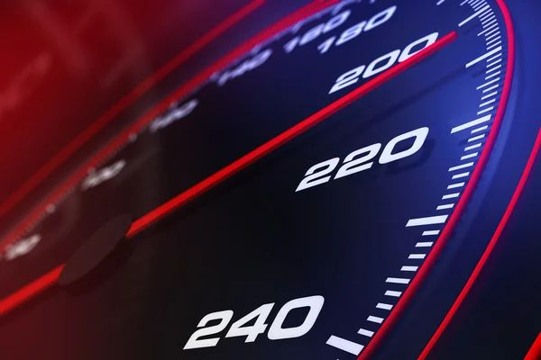
WHY REGRESSION IS THE MAIN TASK
Traffic speed is a continuous variable
Speed directly affects braking behaviour
Predicting speed is more stable and reliable
Figure 6: Speed

Slide 9
WHY NOT DIRECT BRAKING PREDICTION?
Harsh braking events are very rare
Severe class imbalance
Leads to misleading accuracy
Indirect optimization is more effective

Slide 10
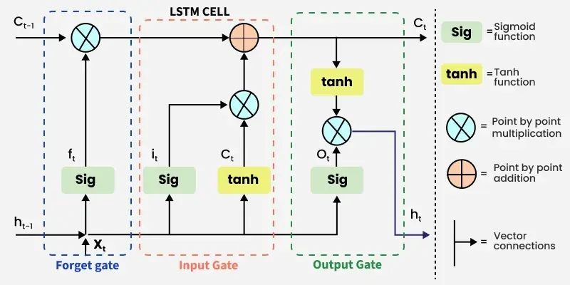

Why LSTM?
ht​=LSTM(xt​,ht−1​)
$x_{t}$: traffic state at time t
$h_{t}$: hidden state (memory)
Designed for sequential data
Captures temporal dependencies
Handles traffic evolution over time
Suitable for time-series forecasting
Figure 7: LSTM Cell

Slide 11
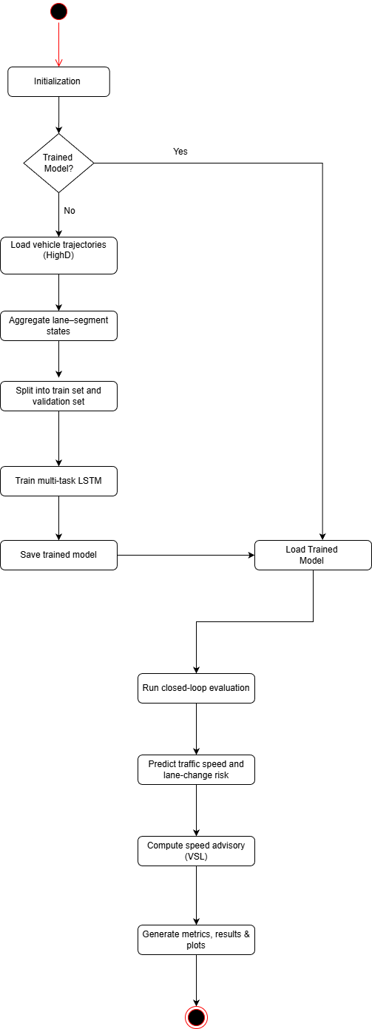
Activity Diagram

Slide 12
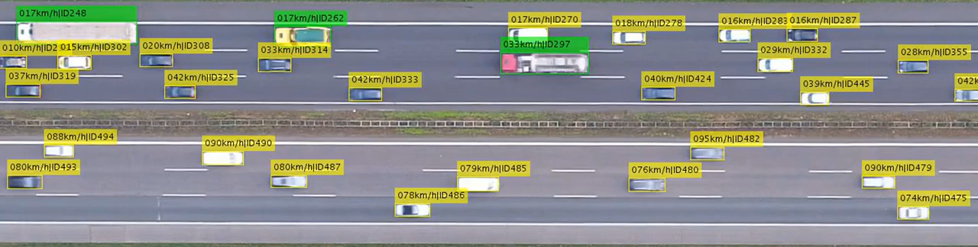
DATASET: HIGHD
Naturalistic driving dataset
German highways
Drone-based recordings
High temporal resolution
Figure 7: High D Dataset

Slide 13

HighD Files Explained and Why Highway = Smart City?
tracks.csv → vehicle trajectories
tracksMeta.csv → vehicle properties
recordingMeta.csv → road & recording info
Smart cities include :Roads ,Traffic infrastructure
Highways are critical urban connectors
Traffic efficiency impacts: Safety ,Emissions, Travel time
Figure 8: Smart City

Slide 14
Traffic State Representation
We aggregate vehicle data into:
Lane segment states
Fixed time steps
This enables:
Traffic-level analysis
Control-oriented modelling

Slide 15
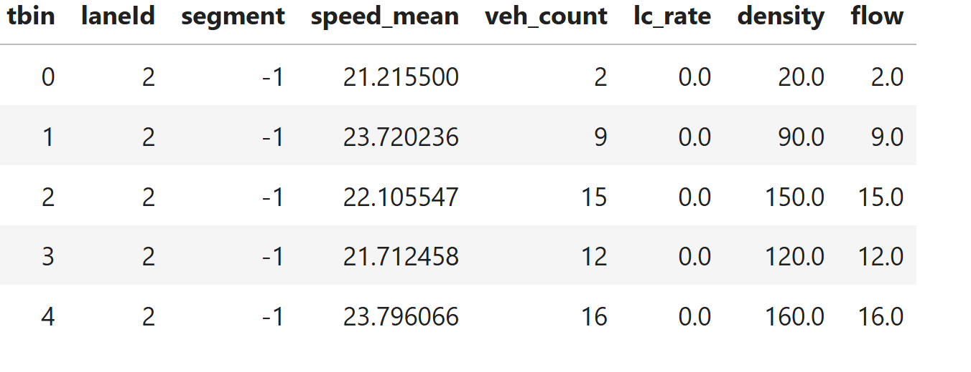
Extracted Features
For each lane segment:
Mean speed
Density
Flow
Lane-change activity
Figure 9: Data

Slide 16
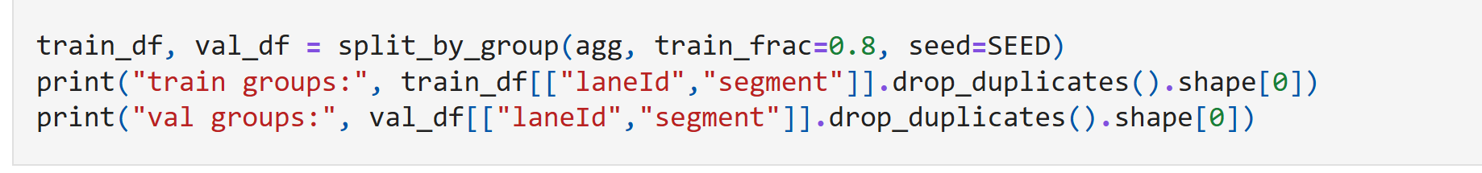
Train / Validation Split
80% training / 20% validation
No temporal leakage
AdamW optimizer
Early stopping
Figure 10: Splitting Code

Slide 17
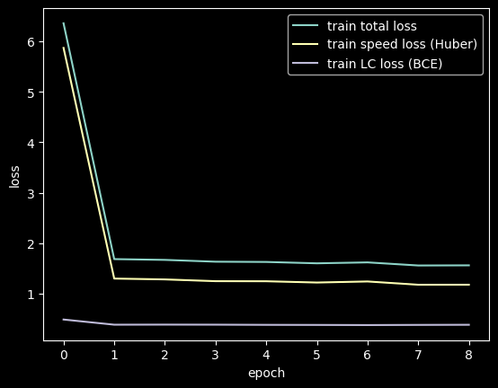

Model Outputs
Speed prediction (m/s)
Lane-change risk (probability)
Loss Functions
Speed (regression):
$$ℒ_{𝓈𝓅ℯℯ𝒹}=Huber\left(y,\hat{y}\right)$$
Lane-change (classification):
$$ℒ_{𝓁𝒸}=BCE\left(y,\hat{y}\right)$$
Total loss:
$$ℒ=ℒ_{𝓈𝓅ℯℯ𝒹}+λℒ_{𝓁𝒸}$$
​
Figure 11: Training curve

Slide 18
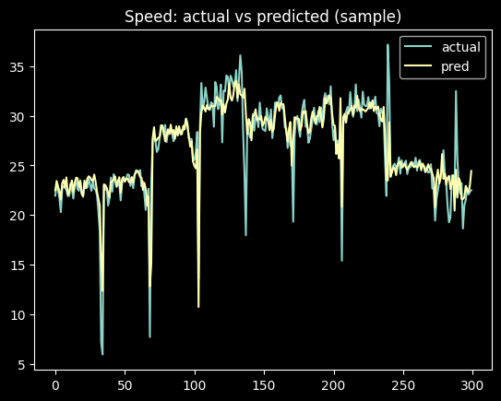
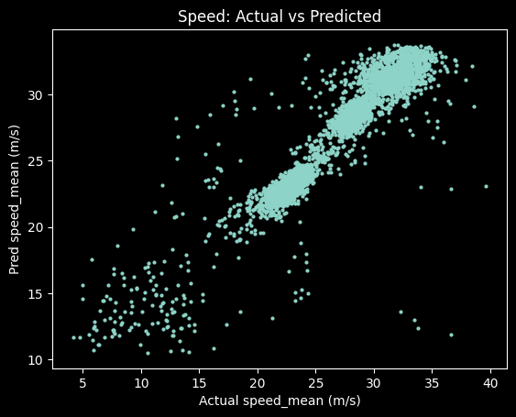
Results: Speed Prediction
MAE ≈ 1.0 m/s
RMSE ≈ 1.7–1.9 m/s
Stable training
Good generalization
Figure 12: Predicted Speeds

Slide 19
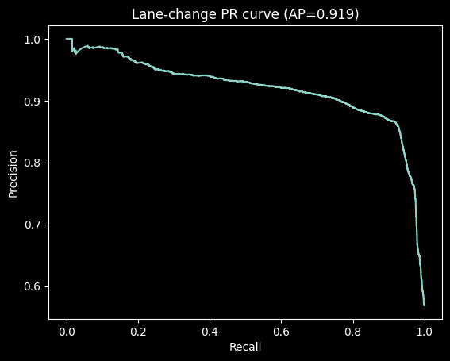
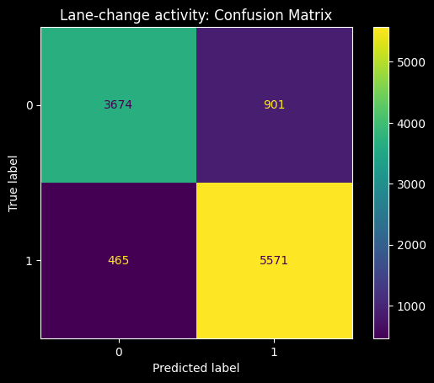
Results: Lane-change Detection
Precision ≈ 0.87
Recall ≈ 0.91
F1-score ≈ 0.89
PR-AUC ≈ 0.92
Figure 13: Lane Change Accuracy

Slide 20
Optimization Strategy
Rule-based Variable Speed Limit (VSL)
Inputs:
Predicted speed
Lane-change risk
Output:
Recommended speed limit

Slide 21
why Rule-Based Optimizer?
Interpretable Stable
No need for reinforcement learning
Suitable for real traffic systems

Slide 22

Closed-loop Evaluation
Apply speed advisory to speed profile
Smooth speed evolution
Compute acceleration proxy
Compare baseline vs optimized
$$a_{t}=\frac{v_{t+1}−v_{t}}{Δt}$$

Slide 23
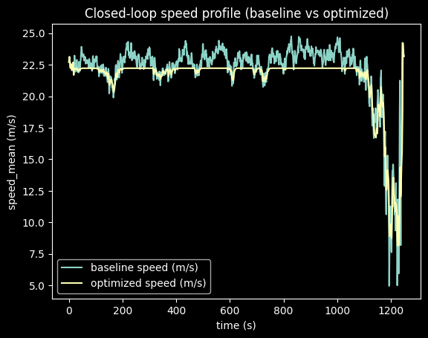
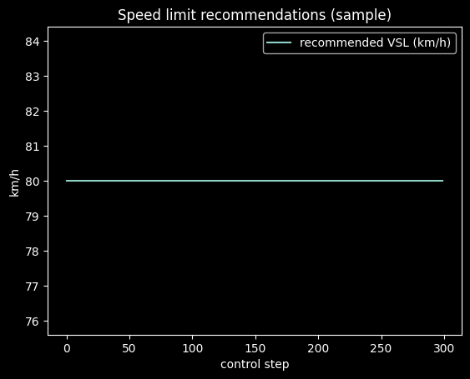
Closed-loop Results
Reduced speed variance
Fewer harsh braking events
Smoother traffic behaviour
Figure 13: Closed Loop Speed Profile

Slide 24
Key Takeaways
Direct braking prediction is ineffective
Speed prediction enables stability
Multi-task learning improves awareness
Rule-based control is practical

Slide 25
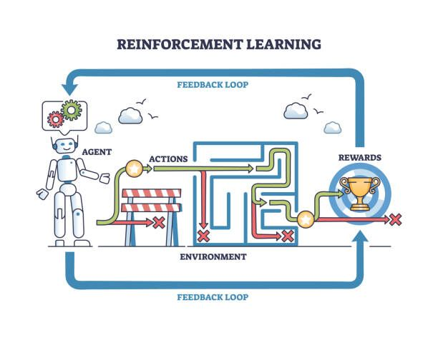
Conclusion and Future
Work
Deep learning can support smart traffic control
LSTM captures traffic dynamics effectively
Indirect optimization reduces braking
Future Work
Microscopic traffic simulation
Reinforcement learning control
Figure 14: Reinforcement Learning

Slide 26
Moye Nyuysoni Glein Perry
THANK YOU!

Slide 27
Picture References
https://leotek.com/wp-content/uploads/2024/02/%E6%9C%AA%E5%91%BD%E5%90%8D%E8%A8%AD%E8%A8%88-2025-02-19T145113.775.jpg
https://unsplash.com/photos/long-exposure-photography-of-road-and-cars-NqOInJ-ttqM
https://www.freepik.com/free-photos-vectors/machine-learning
https://kenovy.com/what-is-deep-learning/

